Slide 1
CLASS 14
ENTRY MODES: FDI

Slide 2
AGENDA
Green field versus M&A
M&A: In Search of synergies
Why M&A tends often to produce less than it promises
A mini case study of the merger between Daimler and Chrysler: The problems that can spoil a (theoretically) perfect marriage
Collaborate or enter on your own
Why collaborate?
Types of collaboration
Joint Ventures’ Risks and Benefits
JV ‘s Divorces
Negotiating a joint venture

Slide 3
WHEN FDI IS THE PREFERRED MODE OF ENTRY?
When transportation costs are high, when regulatory protectionist constraints (e.g., tariffs, quotas, prohibitions etc.) or other barriers limit opportunities for exporting, a firm may consider licensing as another option that may reduce the local knowledge required, the risk and expense of an entry to a foreign market compared to FDI .When licensing ,however, may result in the firm giving away valuable technological knowhow to potential foreign competitors ,when licensing does not give tight enough control to the firm of the production , and marketing strategy associated with the transfer of knowledge needed to ensure quality and maximizing profit, FDI may be the preferred way of entry to a foreign market (despite of the higher risk associated with lack of local knowledge and relationships and the capital required.)
Note that firms do not necessarily follow the selection logic I presented--- often firms imitate their rivals entry patterns, or preempt other firms in an attractive location. Also there are certain advantages
Advantages of FDI: Gaining technology, productive assets, market share ,brand equity, distribution systems, and the like, through FDI by purchasing the assets of an established firm can speed up entry, and improve production in the firm’s home base. Generally being in a foreign market facilitates learning and innovation
TWO Important Choices For FDI mode of entry: M&A versus Green field, solo versus collaboration

Slide 4

GREEN FIELD INVESTMENT ADVANTAGES
Build to suit
Low integration costs
Ease of regulatory approval(?)
Others?
BUT
Stronger reaction from incumbents
Delay
Need to develop demand and develop a workforce
Higher liabilities of foreignness
Others?

Slide 5
MORE GREEN FIELD ADVANTAGES
Are often preferred by governments (Why? Why does it matter?)
May reduce concerns about reduction in local competition ( what are the consequences of such worries?)
Good targets for acquisition are not available
Turning around poor operations is too difficult
Fit and integration costs involved with acquisition can be high

Slide 6
ACQUISITIONS ADVANTAGES
Obtain vital resources that are slow to secure
Get a locally functioning organization
Local brand (if good)
Obtain more easily local financing
Reduce resistance from local incumbents
Immediate cash flow

Slide 7





M&A :THE SYNERGY MATRIX
Managerial Synergy
Improve management or replace inefficient one
Financial Synergy
Redeploy capital
Increase ROI
Company-specific Risk
Cost-of-capital reduction
Operating Synergy
Scale Economies
Improve margins
Market Valuation
Release “value”

Slide 8
Reasons for
M & A
PROBLEMS IN
ACHIEVING SUCCESS
Increased
market power
Integration
difficulties
Overcome
entry barriers
Inadequate
evaluation of target
Cost of new
product development
Large or
extraordinary debt
Increased speed
to market
M & A
Inability to
achieve synergy
Lower risk
compared to developing new products
Too much
diversification
Increased
diversification
Managers overly
focused on acquisitions
Avoid excessive
competition
Too large
Notes:
31

Slide 9
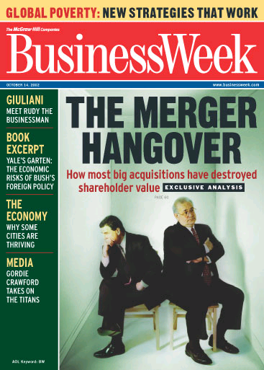
M&A: The Puzzle

Slide 10
Referring to the 20% drop in the price of HP’s shares on the day of announcement of its acquisition of Compaq CEO Fiorina Carly commented:
“You don’t make this kind of move, and judge its success, by the short-term stock price.”
Business Week (Sep. 2001)
Notes:
This comment sounds reasonable, nevertheless, statistically wrong.

Slide 11
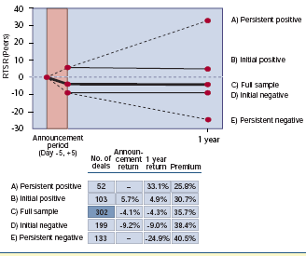
Source: Sirower, BCG, 2005
Notes:
Excluded deals:
Less than $500 million
Deals in which the value of the seller was less than 15% that of the acquirer
Deals in which the acquirer subsequently announced another deal within a year
The sample includes 302 deals, the average acquirer market capitalization was $14.2 BN (5 days before the announcement)
The average seller market cap was $5.5 billion.
Total shareholder return – stock price appreciatetion + dividends
The first year is critical to deliver performance promises. There is research showing that initial market reactions are very good predictor of the acquirer’s operating performance over subsequent years.
The graph shows RTSR – Relative total shareholder return – relative to acquirer's industry peers within the S&P 500
Deals that begin in the right direction and actually deliver – dramatically outperform deals that begin poorly and stay that way.
Investor reactions are powerful forecasts of the future based on previous expectations and the new information given by the company about the strategic and economic wisdom of the transaction.
The often heard statement that initial market reactions are meaningless, or just short term is on balance a myth.

Slide 12
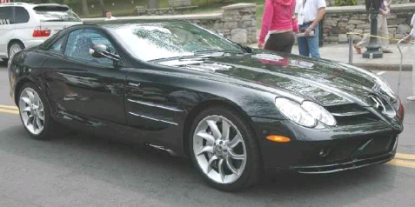
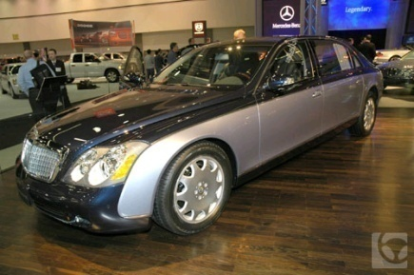
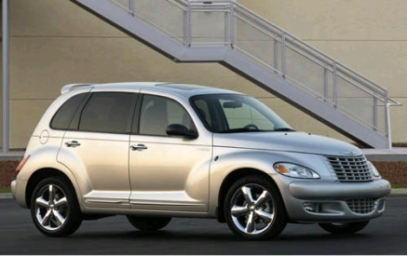
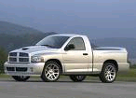
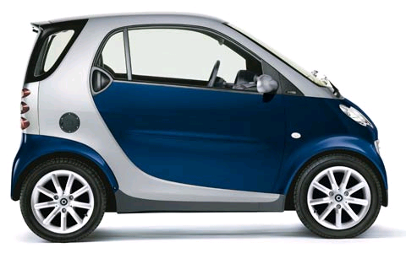

Case: 5/1998 Daimler- Chrysler
&
Marriage made in heaven?

Slide 13
Q. WHAT CHRYSLER TRIED TO ACHIEVE?
  Access to growing markets – more than 90% of their sales were from NAFTA countries
  Enter the luxury market
Q. WHAT DAIMLER TRIED TO ACHIEVE?
  Japanese productivity: single platform with different tops
  Mass market offerings in the U.S.
  Add SUVs and smaller cars to their portfolio
  Avoid becoming a target

Slide 14
Q. WHY DID THE MERGER MAKE SENSE?
Produce transatlantic powerhouse
Economies of scale – manufacturing, suppliers - in hypercompetitive markets you need a big company to survive (?)
Synergies – economies of scope :
  Sharing of tangible resources (R&D, distribution, design)
  Sharing of intangible resources (brands, technology)
  Transferring functional capabilities
  Applying general management capabilities
Notes:
Ask Dr. Z.
http://youtube.com/watch?v=5GwZbRs57Yw
http://youtube.com/watch?v=_tVglVG3SFc
DaimlerChrysler was founded in 1998 when Mercedes-Benz manufacturer Daimler-Benz (1926-1998) of Stuttgart, Germany merged with the US-based Chrysler Corporation.
The deal created a new entity, DaimlerChrysler. However, the buyout failed to produce the trans-Atlantic automotive powerhouse dealmakers had hoped for, and DaimlerChrysler announced on 14 May 2007 that it would sell Chrysler to Cerberus Capital Management of New York, a private equity firm that specializes in restructuring troubled companies,
hrough most of its history, Chrysler has been the third largest of the "Big 3" US auto makers, but in January 2007, DaimlerChrysler, excluding its luxury Mercedes and Maybach lines, also outsold traditionally second place Ford, though behind General Motors and Toyota.
Chrysler reported losses of US$1.5 billion in 2006. It then announced plans to lay off 13,000 employees in mid-February 2007, close a major assembly plant and reduce production at other plants in order to restore profitability by 2008.
The merger was contentious with investors launching lawsuits over whether the transaction was the 'merger of equals' that senior management claimed or actually amounted to a Daimler-Benz takeover of Chrysler.
Another issue of contention is whether the merger delivered promised synergies and successfully integrated the two businesses. As late as 2002, DaimlerChrysler appeared to run two independent product lines. Later that year, the company launched products that appear to integrate elements from both sides of the company, including the Chrysler Crossfire (the car shares 90% components with other Mercedes models) and the Dodge Sprinter/Freightliner Sprinter, a re-badged Mercedes-Benz Sprinter van.
Sale of Chrysler
DaimlerChrysler had reportedly approached other carmakers and investment groups to sell Chrysler in early 2007. General Motors was reported to be a suitor while Volkswagen, the Renault-Nissan auto alliance, and Hyundai Motor Company had said that they weren't interested in buying the company.
On August 3, 2007, DaimlerChysler completed the sale of Chrysler Group to Cerberus Capital Management. The original agreement stated that Cerberus would take an 80.1 percent stake in the new company, Chrysler Holding LLC. DaimlerChrysler changed its name to Daimler AG and retained the remaining 19.9% stake in the separated Chrysler.^{[7]}
The terms saw Daimler pay Cerberus US$650 million to take Chrysler and associated liabilities off its hands. This is a remarkable reverse in fortunes on the US$36 billion paid to acquire Chrysler in 1998. Of the US$7.4 billion purchase price, Cerberus Capital Management will invest US$5 billion in Chrysler Holdings and US$1.05 billion in Chrysler’s financial unit. The de-merged Daimler AG received US$1.35 billion directly from Cerberus but directly invested US$2 billion in Chrysler itself.
Daimler shareholders
The largest voting shareholders of Daimler are the State of Kuwait, with 7.0% (as of September 30 2007), Deutsche Bank with 4.35% (as of May 2 2007), and United Arab Emirates with 2.0% (as of January 1 2006).^{[8]}
The regional breakdown of shareholdings as of September 30 2007 was:^{[8]}
36.7% Germany
36.2% Other Europe
19.8% USA
7.30% Rest of world
[edit] Brands
Daimler sells automobiles under the following marques worldwide:
Mercedes-Benz Cars
Maybach
Mercedes-Benz
Smart
Daimler currently holds interests in the following companies:
85.0% Mitsubishi Fuso Truck and Bus Corporation of Japan
50.1% Automotive Fuel Cell Cooperation of Canada
40.0% McLaren Group of United Kingdom
22.41% European Aeronautic Defence and Space Company (EADS) - a parent company of Airbus of Europe
19.9% Chrysler Holding LLC of United States

Slide 15
WHAT ARE THE EXPECTED SYNERGIES?
Sales – 1 dealership, sales-force for both brands
Productive – cross use facilities; bargaining power with suppliers
R&D – converge to several joint platforms → shorter time to bring new products to the market
Advertising
Administrative costs
Cost of capital
Estimated synergies: $1B in the first year; +$3B later

Slide 16
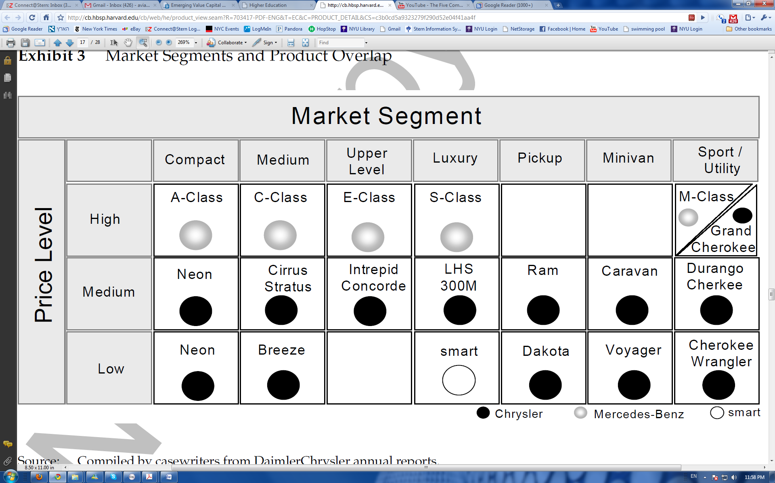
Prof. Aviad Pe'er

Slide 17
DAIMLER CHRYSLER FAILURES
    Despite Contract to Share Parts, Daimler Refused to Share Parts With Chrysler.
    E.g., two months argument: Daimler does not want Mopar Parts to be seen in their dealerships. Sol’n: magnetized sign on Mopar trucks
Costs – German managers do not want to meet in Detroit → work & corporate apartments in Manhattan.
No rationalization – 19,000 new jobs rather than cutting jobs.
Chrysler Management left. Huge Losses.
German Managers sent to turn around Chrysler. This weakened Mercedes.

Slide 18
WHAT HAPPENED IN THE END…
Performance was well below the target of $9B well below the combined revenues of the firms before the merger ( and even below Chrysler’s earnings in 1997)
Rise in Gasoline price and Chrysler's fuel inefficient lineup of cars and integration costs=decision to sell Chrysler
Cerberus acquires Chrysler in May 2007 for $7.4 B. Daimler actually paid Cerberus to take Chrysler considering the net value of assets.

Slide 19
CLASS 6 SEGMENT 2:
COLLABORATIVE FDI STRATEGIES

Slide 20
AGENDA: SEGMENT 2
Why collaborate?
Types of collaboration
Joint Ventures’ Risks and Benefits
JV ‘s Divorces
Negotiating a joint venture

Slide 21
WHY SOLO ENTRY AND NOT COLLABORATE?
Market failure
International transaction costs of collaboration are high. Collaboration requires more negotiations, monitoring and conflict resolution.
Lack of a common culture and standard operating procedures means higher costs of coordination and communications.
Appropriation by rivals of knowledge as well as some other codified resources (e.g. customer list, systems)

Slide 22
TYPES OF COLLABORATION
Scale alliances: aim to provide efficiency by reducing resources and obtaining economies to scale (e.g. airline alliances).
Link alliances: use complementary resources to expand into new business areas
Vertical alliances: links between firms at different levels of the value chain (secure supplies and demand—example Toyota)
Competitors alliances: aim to reduce competition
Horizontal alliances: aim to expand product offerings

Slide 23
MOTIVES FOR COLLABORATION
Spread/reduce costs and risks
Specialize in competencies
Overcome government constraints
Access to complementary resources
Learning

Slide 24
MOTIVES OF INTERNATIONAL COLLABORATION
Gain location specific assets (including knowledge)
Overcome government constraints
Protect local assets and reduce political risk
Diversifying geographically (foster initial entry to multiple markets)

Slide 25
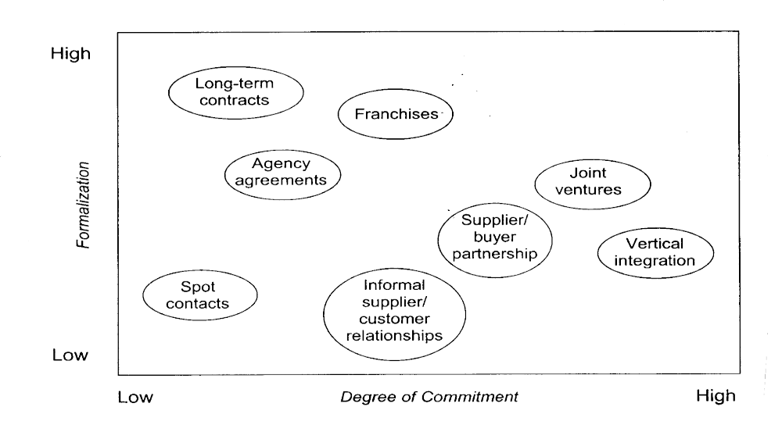
DIFFERENT TYPES OF COLLABORATIVE ARRANGEMENTS

Slide 26
JOINT VENTURES
Benefits:
  Risk sharing
  Synergies
  Learning
  Lower resource inputs
  Risks:
  Opportunistic behavior (hidden agendas)
  Transaction costs and monitoring
  Unfair division of profits and costs
  Appropriation of knowledge
  Creation of a competitor
  High risks of failure and divorce.

Slide 27
JOINT VENTURES
Success Factors
  Goals that fit
  Complementary skills
  Symmetry of contributions and benefits
  Similarity of partners
  Cooperative culture
  Plan for possible divorce

Slide 28
SOME CONSIDERATIONS THAT INFLUENCE THE CHOICE OF COLLABORATIVE ARRANGEMENTS
Control: the more a company depends on collaboration the more likely it is to require higher control.
Prior expansion in a location reduces the need for additional alliances
Compensation (multiple-dimensions, different horizons)

Slide 29
REASONS FOR DIVORCES
Strain due to differences in relative importance of collaboration to partners
Divergent objectives
Control problems
Competitive contribution and appropriation
Differences in culture

Slide 30
DIVORCE SCENARIOS
Planned versus unplanned
Friendly versus unfriendly
Mutually agreed versus disputed upon

Slide 31
OUTCOMES OF DIVORCES
Termination by acquisition
Termination by devolution
Termination by reorganization – restructuring of the alliance
Dealing with partners

Slide 32
DEALING WITH PARTNERS
Finding and evaluating potential partners
Negotiating an agreement (deal with problems of secrecy and protection from appropriation)
Controlling through contracts, trust, and alignment of incentives
Continuous assessment and negotiation

Slide 33
CONSIDERATIONS THAT MAY GUIDE YOU IN NEGOTIATING A JV
What is the best for the actual JV?
What is standard/common international practice?
Are you adopting a long-term or short-term approach?
What is the actual issue for the other party?
What are your and their indifference points?
What can you live with?
Are you leaving sufficient opportunity for profit for each partner?

Slide 34
An intenationalization strategic dilemmas
You are the international manager of a Canadian business that has just developed a revolutionary new personal computer that can perform the same functions as existing PC’s but costs only half as much to manufacture,
Several patents protect the unique design of this computer.
Your CEO has asked you to formulate a recommendation for how to expand to Western Europe.
Your options are :
To export from Canada
To license a European firm to manufacture and market the computer in Europe
To set a wholly owned subsidiary in Europe
Please evaluate the pros and cons of each alternative and suggest a course of action to your CEO.
How tour choices will change if you try to expand to China?
How would you consider expanding to the USA right now?

